Slide 1
Information Retrieval
Topic- Relevance feedback and query expansion
(Query expansion)
Lecture-31
Prepared By
Dr. Rasmita Rautray & Dr. Rasmita Dash
Associate Professor
Dept. of CSE

Slide 2
Query expansion

Slide 3
Content
Relevance feedback: Assumption
Relevance feedback: Evaluation
Query expansion

Slide 4
Relevance
A document is relevant if it gives the user the information she was looking for.

Slide 5
Interactive relevance feedback: improve initial retrieval results by telling the IR system which docs are relevant / non-relevant.
Best known relevance feedback method: Rocchio feedback
Query expansion: improve retrieval results by adding synonyms / related terms to the query
Sources for related terms: Manual thesauri, automatic thesauri, query logs

Slide 6
Relevance feedback: Assumptions
When can relevance feedback enhance recall?
Assumption A1: The user knows the terms in the collection well enough for an initial query.
Assumption A2: Relevant documents contain similar terms

Slide 7
Violation of A1
Assumption A1: The user knows the terms in the collection well enough for an initial query.
Violation: Mismatch of searcher’s vocabulary and collection vocabulary
Example: cosmonaut / astronaut

Slide 8
Violation of A2
Assumption A2: Relevant documents are similar.
Example for violation: [contradictory government policies]
Several unrelated “prototypes”
Subsidies for tobacco farmers vs. anti-smoking campaigns
Aid for developing countries vs. high tariffs on imports from developing countries
Relevance feedback on tobacco docs will not help with finding docs on developing countries.

Slide 9
Relevance feedback: Assumptions
When can relevance feedback enhance recall?
Assumption A1: The user knows the terms in the collection well enough for an initial query.
Assumption A2: Relevant documents contain similar terms (so I can “hop” from one relevant document to a different one when giving relevance feedback).

Slide 10
Relevance feedback: Evaluation
Pick an evaluation measure, e.g., precision in top 10: P@10
Compute P@10 for original query q₀
Compute P@10 for modified relevance feedback query q₁
In most cases: q₁ is spectacularly better than q₀!
Is this a fair evaluation?

Slide 11
Relevance feedback: Problems
Relevance feedback is expensive.
Relevance feedback creates long modified queries.
Long queries are expensive to process.
Users are reluctant to provide explicit feedback.
It’s often hard to understand why a particular document was retrieved after applying relevance feedback.
The search engine Excite had full relevance feedback at one point, but abandoned it later.

Slide 12
Pseudo-relevance feedback
Pseudo-relevance feedback automates the “manual” part of true relevance feedback.
Pseudo-relevance feedback algorithm:
Retrieve a ranked list of hits for the user’s query
Assume that the top k documents are relevant.
Do relevance feedback (e.g., Rocchio)
Works very well on average
But can go horribly wrong for some queries.
Because of query drift
If you do several iterations of pseudo-relevance feedback, then you will get query drift for a large proportion of queries.

Slide 13
Types of user feedback
User gives feedback on documents.
More common in relevance feedback
User gives feedback on words or phrases.
More common in query expansion

Slide 14
Query expansion
Query expansion is another method for increasing recall.
We use “global query expansion” to refer to “global methods for query reformulation”.
In global query expansion, the query is modified based on some global resource, i.e. a resource that is not query-dependent.
Main information we use: (near-)synonymy

Slide 15
“Global” resources used for query expansion
A publication or database that collects (near-)synonyms is called a thesaurus.
Manual thesaurus (maintained by editors, e.g., PubMed)
Automatically derived thesaurus (e.g., based on co-occurrence statistics)
Query-equivalence based on query log mining (common on the web as in the “palm” example)

Slide 16
Thesaurus-based query expansion
For each term t in the query, expand the query with words the thesaurus lists as semantically related with t.
Example from earlier: HOSPITAL → MEDICAL
Generally increases recall
May significantly decrease precision, particularly with ambiguous terms
INTEREST RATE → INTEREST RATE FASCINATE
Widely used in specialized search engines for science and engineering
It’s very expensive to create a manual thesaurus and to maintain it over time.

Slide 17
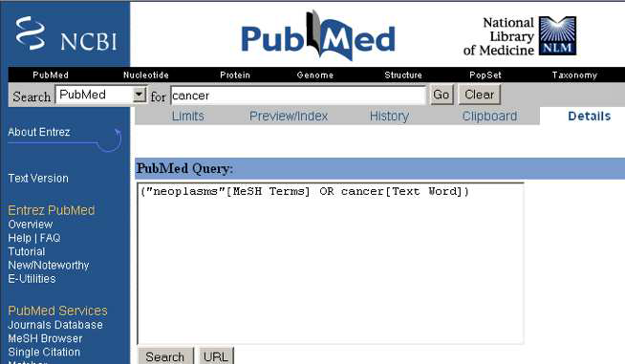
Example for manual thesaurus: PubMed

Slide 18
Automatic thesaurus generation
Attempt to generate a thesaurus automatically by analyzing the distribution of words in documents
Fundamental notion: similarity between two words
Definition 1: Two words are similar if they co-occur with similar words.
“car” ≈ “motorcycle” because both occur with “road”, “gas” and “license”, so they must be similar.
Definition 2: Two words are similar if they occur in a given grammatical relation with the same words.
You can harvest, peel, eat, prepare, etc. apples and pears, so apples and pears must be similar.
Co-occurrence is more robust, grammatical relations are more accurate.

Slide 19
Query expansion at search engines
Main source of query expansion at search engines: query logs
Example 1: After issuing the query [herbs], users frequently search for [herbal remedies].
→ “herbal remedies” is potential expansion of “herb”.
Example 2: Users searching for [flower pix] frequently click on the URL photobucket.com/flower. Users searching for [flower clipart] frequently click on the same URL.
→ “flower clipart” and “flower pix” are potential expansions of each other.

Slide 20
Take-away today Interactive
Interactive relevance feedback: improve initial retrieval results by telling the IR system which docs are relevant / non-relevant
Best known relevance feedback method: Rocchio feedback
Query expansion: improve retrieval results by adding synonyms / related terms to the query
Sources for related terms: Manual thesauri, automatic thesauri, query logs

Slide 21
Thank You

